Slide 1

UNIT-1
Syntax and Semantics
Prepared By:
Dr. Archana Sharma
archana@delhitechnicalcampus.ac.in

Slide 2
Syntax
Is the form of its expressions, statements, and program units.
For example the syntax of a Java while statement is
  while (boolean_expr) statement
Structure of Programming Language

Slide 3
Semantics
Is the meaning of those expressions, statements, and program
units.
For example the syntax of a Java while statement is
while (boolean_expr) statement
The semantics of this statement form is that when the current value of the Boolean expression is true, the embedded statement is executed. Otherwise, control continues after the while construct. Then control implicitly returns to the Boolean expression to repeat the process.
Structure of Programming Language

Slide 4
Example statement or sentence
index = 2 * count + 17
Lexemes
Index
=
2
Tokens identifier equal_sign int_literal mult_op identifier plus_op int_literal semicolon
*
Count
+ 17
;
Structure of Programming Language

Slide 5
Formal Methods of Describing Syntax
Metalanguage. is a language that is used to describe another language.
BNF(Backus-Naur Form) is a metalanguage for programming languages. Example
A simple Java assignment statement.
The actual definition of <assign> can be given by;
<assign> →<var> =<expression>
Structure of Programming Language

Slide 6
<assign> →<var> =<expression>
(LHS) The text on the left side of the arrow.
(RHS) consists of some mixture of tokens, lexemes, and references to other abstractions.
Structure of Programming Language

Slide 7
The abstractions in a BNF description, or grammar, are often called
nonterminal symbols, or simply nonterminals.
The lexemes and tokens of the rules are called terminal symbols, or simply
terminals.
A BNF description, or grammar, is a collection of rules.

Slide 8
Nonterminal symbols can have two or more distinct definitions, representing two or more possible syntactic forms in the language.
Multiple definitions can be written as a single rule, with the different definitions separated by the symbol|, meaning logical OR.
Java if statement can be described with the rules;
<if_stmt> → if (<logic_expr> ) <stmt>
<if_stmt> → if (<logic_expr> )<stmt> else<stmt>
or with the rule
<if_stmt> → if (<logic_expr> )<stmt>
|if (<logic_expr> )<stmt> else<stmt>
In these rules, <stmt> represents either a single statement or a compound statement.

Slide 9
Describing Lists
Variable-length lists in mathematics are often written using an ellipsis (. . .);
BNF does not include the ellipsis, so an alternative method is required for
describing lists of syntactic elements in programming languages.
For BNF, the alternative is recursion.
A rule is recursive if its LHS appears in its RHS. The following rules illustrate how recursion is used to describe lists:
<ident_list> →identifier
|identifier, <ident_list>
This defines <ident_list> as either a single token (identifier) or an identifier followed by a comma and another instance of <ident_list>.
Structure of Programming Language

Slide 10
Grammars and Derivations
A grammar is a generative device for defining languages.
The sentences of the language are generated through a sequence of applications of the rules, beginning with a special nonterminal of the grammar called the start symbol.
This sequence of rule applications is called a derivation.
Structure of Programming Language

Slide 11
EXAMPLE
A Grammar for a Small Language
<program> → begin<stmt_list> end
<stmt_list> →<stmt>
|<stmt> ;<stmt_list>
<stmt> →<var> =<expression>
<var> → A | B | C
<expression> →<var> +<var>
|<var> –<var>
|<var>
Structure of Programming Language

Slide 12
Derivations
In this derivation, the replaced nonterminal is always the leftmost nonterminal in the previous sentential form.
The derivation continues until the sentential form contains no non terminals.
That sentential form, consisting of only terminals, or lexemes, is the generated sentence.
Structure of Programming Language

Slide 13
A derivation of a program in this language follows:
<program> => begin<stmt_list> end
=> begin <stmt> ;<stmt_list> end
=> begin <var> =<expression> ;<stmt_list> end
=> begin A =<expression> ;<stmt_list> end
=> begin A =<var> +<var> ;<stmt_list> end
=> begin A = B +<var> ;<stmt_list> end
=> begin A = B + C ;<stmt_list> end
=> begin A = B + C ;<stmt> end
=> begin A = B + C ;<var> =<expression> end
=> begin A = B + C ; B =<expression> end
=> begin A = B + C ; B =<var> end
=> begin A = B + C ; B = C end
Structure of Programming Language

Slide 14
EXAMPLE
A Grammar for Simple Assignment Statements
<assign> →<id>= <expr>
<id> → A | B | C
<expr> →<id>+ <expr>
|<id>* <expr>
| ( <expr>)
|<id>
Structure of Programming Language

Slide 15
For example, the statement A = B * ( A + C )
The leftmost derivation:
<assign> =><id> =<expr>
=> A = <expr>
=> A = <id> *<expr>
=> A = B * <expr>
=> A = B * ( <expr>)
=> A = B * ( <id> +<expr>)
=> A = B * ( A + <expr>)
=> A = B * ( A + <id>)
=> A = B * ( A + C )
Structure of Programming Language

Slide 16
Parse Trees
One of the most attractive features of grammars is that they naturally describe the hierarchical syntactic structure of the sentences of the languages they define.
These hierarchical structures are called parse trees.
Structure of Programming Language

Slide 17
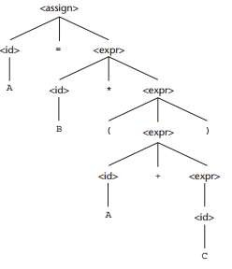
A parse tree for the simple statement A = B * (A + C)

Slide 18
Attribute Grammars

Slide 19
Static Semantics
Nothing to do with meaning
Context-free grammars (CFGs) cannot describe all of the syntax of programming languages
Categories of constructs that are trouble:
  Context-free, but cumbersome (e.g., types of operands in expressions)
  Non-context-free (e.g., variables must be declared before they are used)

Slide 20
Attribute Grammars
Attribute grammars (AGs) have additions to CFGs to carry some semantic info on parse tree nodes
Primary value of AGs:
  Static semantics specification
  Compiler design (static semantics checking)

Slide 21
Attribute Grammars : Definition
Def: An attribute grammar is a context-free grammar G = (S, N, T, P) with the following additions:
  For each grammar symbol x there is a set A(x) of attribute values
  Each rule has a set of functions that define certain attributes of the nonterminals in the rule
  Each rule has a (possibly empty) set of predicates to check for attribute consistency

Slide 22
Attribute Grammars: Definition
Let X₀ → X₁ ... X_{n} be a rule
Functions of the form S(X₀) = f(A(X₁), ... , A(X_{n}))
define synthesized attributes
Functions of the form I(X_{j}) = f(A(X₀), ... , A(X_{n})), for i <= j <= n, define inherited attributes
Initially, there are intrinsic attributes on the leaves

Slide 23
Attribute Grammars: An Example
Syntax rule:
<proc_def> → procedure <proc_name>[1]
<proc_body> end <proc_name>[2];
Predicate:
<proc_name>[1]string == <proc_name>[2].string
1-26

Slide 24
Attribute Grammars: An Example
Syntax
<assign> → <var> = <expr>
<expr>
<var>
→ <var> + <var> | <var>
→ A | B | C
actual_type: synthesized for <var> and <expr>
expected_type: inherited for <expr>
1-26

Slide 25
Attribute Grammar (continued)
Syntax rule:
<expr> → <var>[1] + <var>[2]
Semantic rules:
<expr>.actual_type
Predicate:
← <var>[1].actual_type
<var>[1].actual_type | == | <var>[2].actual_type
<expr>.expected_type | == | <expr>.actual_type
Syntax rule:
<var> → id
Semantic rule:
<var>.actual_type ← lookup (<var>.string)
1-<number>

Slide 26
Attribute Grammars (continued)
How are attribute values computed?
  If all attributes were inherited, the tree could be decorated in top-down order.
  If all attributes were synthesized, the tree could be decorated in bottom-up order.
  In many cases, both kinds of attributes are used, and it is some combination of top-down and bottom-up that must be used.
1-<number>

Slide 27
Attribute Grammars (continued)
<expr>.expected_type ← inherited from parent
<var>[1].actual_type | ← | lookup | (A)
<var>[2].actual_type | ← | lookup | (B)
<var>[1].actual_type =? <var>[2].actual_type
<expr>.actual_type | ← | <var>[1].actual_type
<expr>.actual_type | =? | <expr>.expected_type
1-<number>

Slide 28
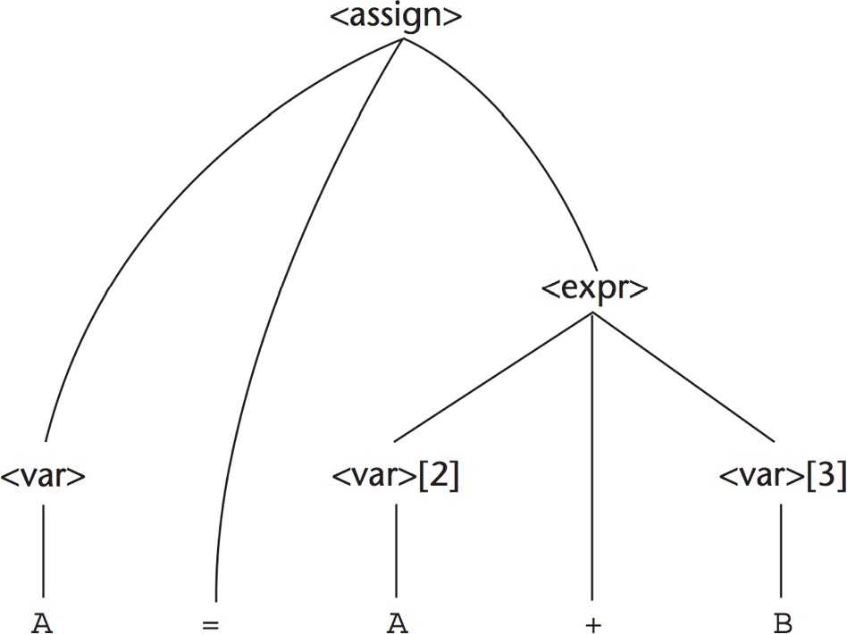
Parse Tree
uT D

Slide 29
Computing Attribute Values
uT D
<var>.actual_type ← look-up(A) (Rule 4)
<expr>.expected_type ← <var>.actual_type (Rule 1)
<var>[2].actual_type ← look-up(A) (Rule 4)
<var>[3].actual_type ← look-up(B) (Rule 4)
<expr>.actual_type ← either int or real
(Rule |  | 2)
5. is | <expr>.expected_type either |  |  |  |  | == | <expr>.actual_type
TRUE |  | or | FALSE | (Rule | 2)

Slide 30
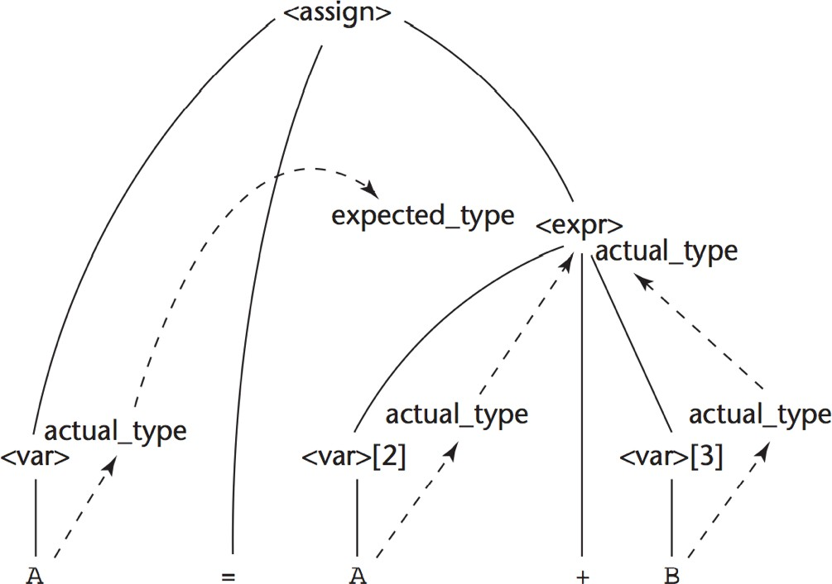
Flow of Attributes in the Tree

Slide 31
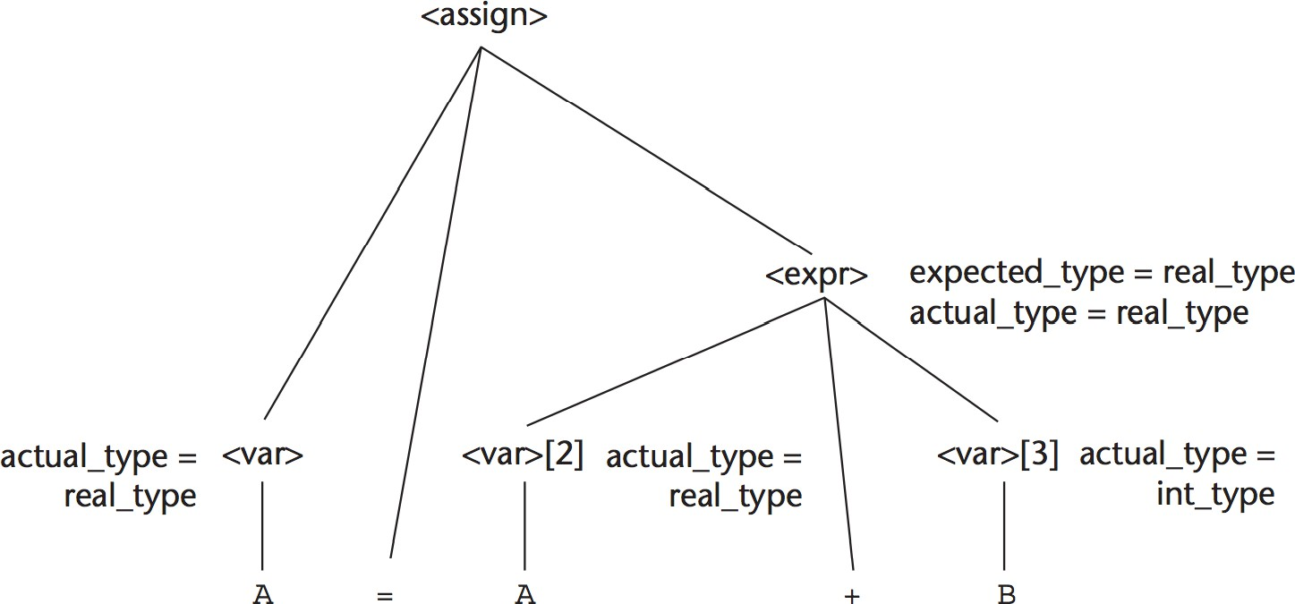
A Fully Attributed Parse Tree
uT D

Slide 32
Semantics

Slide 33
Semantics
There is no single widely acceptable notation or formalism for describing semantics
Several needs for a methodology and notation for semantics:
  Programmers need to know what statements mean
  Compiler writers must know exactly what language constructs do
  Correctness proofs would be possible
  Compiler generators would be possible
  Designers could detect ambiguities and inconsistencies
1-30

Slide 34
Semantics
uT D
Operational Semantics
Denotational Seman
45

Slide 35
Operational Semantics
Operational Semantics
– Describe the meaning of a program by executing its statements on a machine, either simulated or actual. The change in the state of the machine (memory, registers, etc.) defines the meaning of the statement
To use operational semantics for a high-level language, a virtual machine is needed
1-<number>

Slide 36
Operational Semantics
A hardware pure interpreter would be too expensive
A software pure interpreter also has problems
  The detailed characteristics of the particular computer would make actions difficult to understand
  Such a semantic definition would be machine- dependent
1-<number>

Slide 37
Operational Semantics (continued)
A better alternative: A complete computer simulation
The process:
  Build a translator (translates source code to the machine code of an idealized computer)
  Build a simulator for the idealized computer
Evaluation of operational semantics:
  Good if used informally (language manuals, etc.)
  Extremely complex if used formally (e.g., VDL), it was used for describing semantics of PL/I.
1-<number>

Slide 38
Operational Semantics (continued)
Uses of operational semantics:
  Language manuals and textbooks
  Teaching programming languages
Two different levels of uses of operational semantics:
  Natural operational semantics
  Structural operational semantics
Evaluation
  Good if used informally (language manuals, etc.)
  Extremely complex if used formally (e.g.,VDL)
1-<number>

Slide 39
Denotational Semantics
Based on recursive function theory
The most abstract semantics description method
Originally developed by Scott and Strachey (1970)
1-<number>

Slide 40
Denotational Semantics - continued
The process of building a denotational specification for a language:
- Define a mathematical object for each language entity
– Define a function that maps instances of the language entities onto instances of the corresponding mathematical objects
The meaning of language constructs are defined by only the values of the program's variables
1-<number>

Slide 41
Denotational Semantics: program state
The state of a program is the values of all its current variables
s = {<i₁, v₁>, <i₂, v₂>, …, <i_{n}, v_{n}>}
Let VARMAP be a function that, when given a variable name and a state, returns the current value of the variable
VARMAP(i_{j}, s) = v_{j}
1-<number>

Slide 42
Evaluation of Denotational Semantics
Can be used to prove the correctness of programs
Provides a rigorous way to think about programs
Can be an aid to language design
Has been used in compiler generation systems
Because of its complexity, it is of little use to language users
1-<number>

